Slide 1
Nonprofit Security Grant Program
-Project Management

Slide 2

Welcome
Let's get our ducks in a row
Some information to get us started:
SAA’s Role in your awardee journey
Administrative tasks before beginning
Environmental Historic Preservation (EHP)
Project management through to close-out
Resources
https://www.Datacounts.net/nsgp
Q&A
This Photo by Unknown Author is licensed under CC BY

Slide 3

Congratulations!
You are officially a subrecipient of the Nonprofit Security Grant Program and we will be with you every step of the way.
As the State Administrative Agency for the Nonprofit Security Grant Program, we will be your pass-through and oversight contact from start, during and to completion of your projects.
The 2024 Nonprofit Security Grant Program (NSGP) project performance period runs from October 1, 2024, to May 31, 2027.
Upon receipt of notice of award, the following administrative requirements must be complete before funds can be accessed:
Receive, review, sign and return your award agreement to the SAA
Address any financial holds that may be listed in the articles of your award agreement
  Holds will require additional submission of information to FEMA for pending approval, which could extend past the original start date for funding. Reimbursement cannot be done without release of holds as approved by FEMA.
Complete and submit a current W-9 for your organization
Sign and return a Sexual Harassment form
Sign and return an Israeli Boycott form
Sign and return a Covered Technology form
Provide a table of expenses for contracted security personnel, if applicable

Slide 4
Environmental Historic Preservation (EHP)
Before physical work on your facility can begin:
an Environmental Historic Preservation (EHP) assessment must be submitted and approved by FEMA.
Make sure all involved in this project, facility management, and fiscal agents are aware, work cannot begin until FEMA provides EHP approval.
You will submit your EHP to the SAA at nsgp.khp@ks.gov to review and submit to FEMA on your behalf.
Do not begin physical enhancements to your facility until you receive an official FEMA approval letter that will be forwarded from the SAA.
Reimbursements for work completed prior to the designated performance period cannot be reimbursed.
There are previously hosted webinars with a focus on existing awardee project management, targeting help with Procurement, Reimbursement and Environmental (EHP) technical assistance at https://www.Datacounts.net/nsgp
Simply click on Training Materials at the top of the page and locate the topic you need more help on.
Of course, if you need extra help, email our team at NSGP.KHP@KS.GOV

Slide 5
Enhancing the Protection of Soft Targets/Crowded Places
Private contracted security guards
Physical security enhancements
Closed circuit television (CCTV) security cameras
Security screening equipment for people and baggage
Access controls
Fencing, gates, barriers, etc.
Card readers, associated hardware/software cybersecurity enhancements
Risk-based cybersecurity planning and training
Improving cybersecurity of access control and identify verification systems
Improving cybersecurity of security technologies (e.g., CCTV systems)
Adoption of cybersecurity performance goals (CISA's Cross-Sector Cybersecurity Performance Goals)

Slide 6
Remember your approved activities
Planning
Conduct or enhancement of security and risk assessments. Development of security plans and protocols, emergency/contingency plans, evacuation/shelter plans in place.
Equipment
Only the equipment approved in your Investment Justification.
Equipment is to be maintained in good working order for the life of equipment.
An inventory is required to be maintained by the End User for the life of equipment and reconciled semi-annually.
The SAA will work with the End User to reconcile annual inventory no later than September 30th. Next Annual Inventory due September 30, 2024.
The SAA is required to conduct two on-sight visits to monitor equipment requirements.

Slide 7
Training
Active shooter training, including, integrating the needs of persons with disabilities, security training for employees, public awareness/preparedness campaigns.
Training should be included in the cost of equipment. We encourage cross-training.
Planning, Training, Exercise and Equipment should consider ADA compliance.
Obtain pre-approval for any reasonable modifications to the project.
Exercise
Response exercises.
Contracted Security Personnel
Must be specific to your facility and all rates, number of services/activities, recourses, time and number of personnel must be planned out for the life of the project.

Slide 8
FEMA training initiative resources
ACTIVE SHOOTER PREPAREDNESS
https://www.cisa.gov/active-shooter-preparedness
https://www.cisa.gov/translated-active-shooter-resources
ACTIVE SHOOTER PREPAREDNESS WORKSHOP/WEBINAR AND RESOURCES
https://www.cisa.gov/active-shooter-workshop-participant
EMPLOYEE VIGILANCE SECURITY SOFT SKILLS
https://www.cisa.gov/employee-vigilance-security-soft-skills
EMPLOYEE VIGILANCE - POWER OF HELLO
https://www.cisa.gov/power-hello
INSIDER THREAT MITIGATION
https://www.cisa.gov/insider-threat-mitigation
DE-ESCALATION SERIES
https://www.cisa.gov/de-escalation-series
Notes:
There is even a Translated active shooter link https://www.cisa.gov/translated-active-shooter-resources

Slide 9
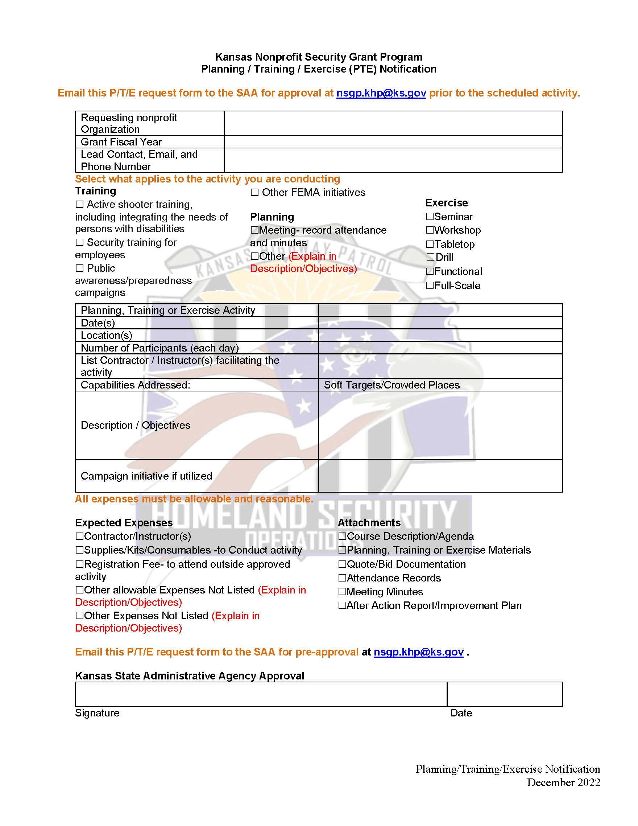
Pre-Approval of Planning/Training/Exercise
Moving forward - All Planning, Training and Exercise activities where NSGP funds will be utilized will require pre-approval prior to the activity date.
This form was created to help ensure that all Planning, Training and Exercise expenses are pre-approved, allowable, and all required documentation is obtained and submitted for a seamless reimbursement process.
When sending in your reimbursement form and itemized invoice, please include any supporting source documentation to NSGP.KHP@KS.GOV and carbon copy KHP.Homeland@KS.GOV

Slide 10
Equipment & Accountability
Applicants should analyze the cost benefits of purchasing versus leasing equipment, especially high-cost items and those subject to rapid technical advances.
Large equipment purchases must be identified and explained.
For additional guidance, please reach out to the SAA at NSGP.KHP@KS.GOV
The installation of certain equipment may trigger EHP requirements. Please reference the EHP sections in the NOFO and this Manual for more information. Additionally, some equipment installation may constitute construction or renovation.
Subrecipients should have a method of accountability for equipment and supplies purchased with NSGP funding. Example - Access control, access to technology and access to sensitive materials. A plan/protocol should be put in place to identify who has access, log of check-out/check-in, what happens if that person who has access leaves the organization, etc.

Slide 11
M&A Summary
You may only request M&A reimbursement for:
Hiring of full-time or part-time staff or contractors/consultants responsible for activities relating to the management and administration of NSGP funds.
Hiring of contractors/consultants must follow the applicable federal procurement requirements at 2 C.F.R. §§ 200.317-200.327.
Meeting-related expenses directly related to M&A of NSGP funds.
M&A costs are allowed under this program as described below:
• Nonprofit (Subrecipient) for NSGP-UA and NSGP-S, and Community Project Funding M&A: Nonprofit organizations that receive a subaward under this program may use and expend up to the percent noted in the relevant fiscal year (FY) NOFO for M&A purposes associated with the subaward.
All these costs must be reasonable and be supported with documentation.
Notes:
Show EHP tool in datacounts. Webinars on managing the grant may count as “meeting”.

Slide 12
Procurement Thresholds
Expense at or less than $4,999.99
  No competitive bidding - do shop around for best quality at a reasonable price. Best practice is research best costs with at least 3 vendors
  *Note* if you are spending more than $4,999.99 in one fiscal year on one vendor → go to the next threshold
  Follow your policy fiscal year or state policy
Expense between $5,000 to $24,999.99
  Minimum of three (3) quotes received
Expense between $25,000 to $49,999.99
  Sealed bid process used, Invitation to Bid, Public Bulletin Board (your nonprofit website) – minimum ten calendar days
  *Note* Best practice is to post all bids on Kansas Register that exceed $25,000.00
Expense at or greater than $50,000
  Sealed bid process used, Invitation to Bid, post on Kansas Register https://sos.ks.gov/publications/kansas-register.html - minimum of ten business days, excluding holidays and minus the first & last day of posting (+2). You can utilize M&A for this cost as long as it was listed and approved in your IJ
  Procurement & Reimbursement resources are available at http://www.datacounts.net/nsgp for review or refresher.
Notes:
You can review the Authorized Equipment List on datacounts

Slide 13
Reimbursement process
Now that the work is completed - you have inspected and approved of final service or product:
Complete the provided Reimbursement Request Form
Prepare, organize, and attach your supporting documentation that will match your reimbursement requests
Supporting documentation - also known as Source Documentation includes as applicable
Procurement Checklist
Bids or quotes
Bid or quote tabulation sheet - this sheet lists out all bids or quotes obtained
Pre-Approval forms such as for Planning/Training/Exercise. Also email approvals
Correspondence
Sealed bid information
Cancelled checks – if the cancelled check is for multiple charges or invoices, please note this (breaking out costs) on the copy or summary you will be providing the SAA
Any other documents that support your itemized invoice listing. Only pre-approved items or activities
Electronic reimbursement requests will be sent to the SAA at nsgp.khp@ks.gov and carbon copy KHP.Homeland@KS.GOV
Email subject should be - Reimbursement Request, fiscal year, nonprofit name, reimbursement number (Reimbursement Request FY22 name of your nonprofit #1)
*Note* submit reimbursements as they are incurred to ensure timely pass-through of funds. If proof of payment is not submitted at the time of reimbursement, you must have proof of payment within 45 days of submitting the reimbursement request but as soon as possible.

Slide 14
Records Retention
Records Retention Period of financial records, supporting documents, statistical records, and all other non-federal entity records pertinent to a federal award generally must be maintained for at least three years from the date of successful close of the award, which is normally 90 days after the end of FEMA’s performance period.
Types of Records to Retain: FEMA requires that non-federal entities maintain the following documentation for federally funded purchases
• Specifications
• Solicitations
• Competitive quotes or proposals
• Basis for selection decisions
• Purchase orders
• Contracts
• Invoices
• Canceled checks
You should keep detailed records of all transactions involving the grant. FEMA may at any time request copies of any relevant documentation and records, including purchasing documentation along with copies of canceled checks for verification. See e.g., 2 C.F.R. §§ 200.318(i), 200.334, 200.337. Preparedness Grants Manual | May 2022 44. In order for any cost to be allowable, it must be adequately documented per 2 C.F.R. § 200.403(g). Nonfederal entities who fail to fully document all purchases may find their expenditures questioned and subsequently disallowed.

Slide 15
Resources
Nonprofit Security Grant Program Resources
http://datacounts.net/nsgp
FEMA-NSGP Guidance
https://www.fema.gov/grants/preparedness/nonprofit-security
Preparedness Grants Manual
https://www.fema.gov/grants/preparedness
Kansas Procurement
https://www.admin.ks.gov/offices/procurement-and-contracts
Code of Federal Regulations
https://www.ecfr.gov/cgi-bin/ECFR?page=browse
Kansas Homeland Security Preparedness Grant Programs Policy Manual
http://datcounts.net/nsgp
Hometown Security
https://www.cisa.gov/hometown-security
Faith Based Organizations - Houses of Worship
https://www.cisa.gov/faith-based-organizations-houses-worship
Notes:
Quarterly reports are required until the project is complete.

Slide 16

Contacts
Captain Amber Harrington K-265
KHP - Homeland Security/Emergency Operations
122 SW 7th Street, Topeka, KS 66603-3847
(785) 296-6800
Amber.harrington@ks.gov
Lieutenant Edna Cordner K-299
KHP - Homeland Security / Emergency Operations
122 SW 7th Street, Topeka, KS 66603-3847
(785) 207-0423 (Cell)
Edna.cordner@ks.gov
Melissa McCoy
Program Consultant I
KHP - Homeland Security / Emergency Operations
122 SW 7th Street, Topeka, KS 66603-3847
(785) 368-7187 (Office)
(785) 925-2148 (Cell)
Melissa.McCoy@ks.gov
Melanie Lawrence
Program Consultant II
KHP - Homeland Security/Emergency Operations
122 SW 7th Street, Topeka, KS 66603-3847
(785) 296-6654 (Office)
(785) 256-5191 (Cell)
Melanie.Lawrence@ks.gov
Connie Satzler
EnVisage Consulting
Web portal and IJ assistance
6847 Anderson Ave. Manhattan, KS 66503
Phone: (785) 410-0410
csatzler@kansas.net
Http://www.datacounts.net/nsgp
Notes:
Quarterly reports are required until the project is complete.

Slide 17
Questions?
NSGP.KHP@KS.GOV

